Slide 1
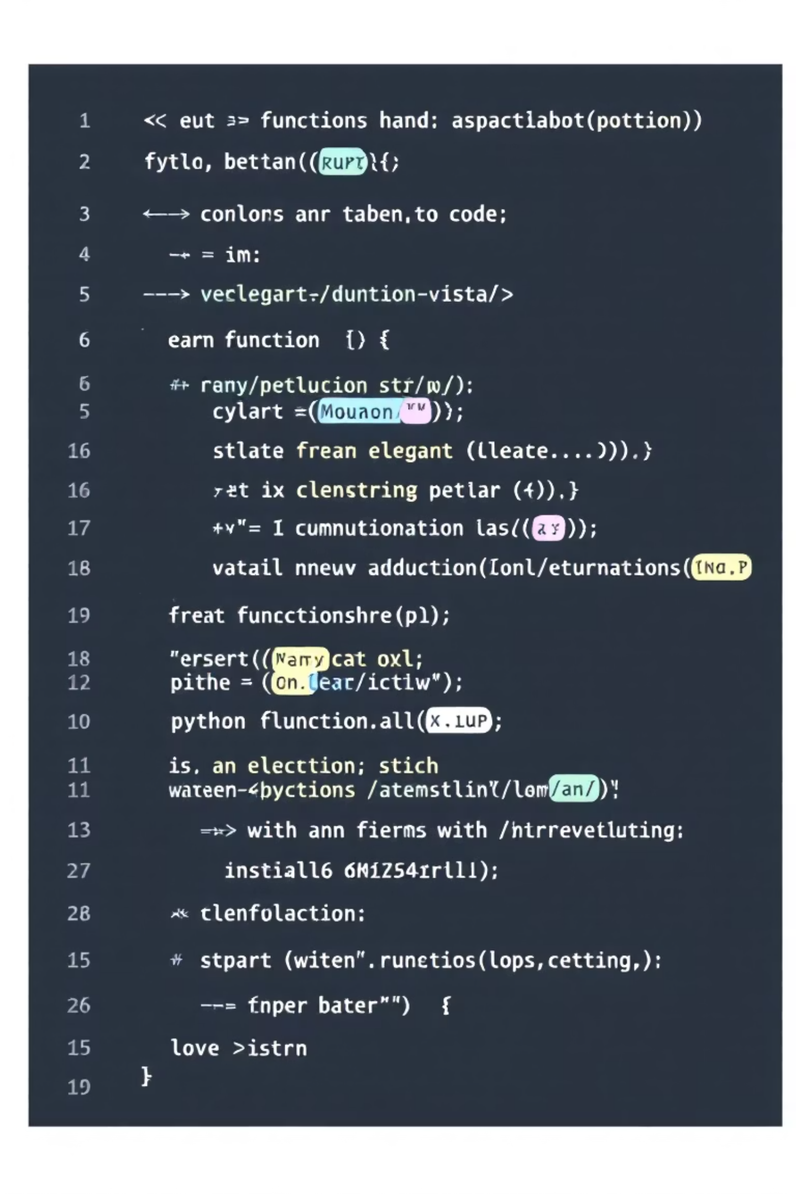
Understanding Functions in Python:
Presented by:
RHIMJHIM
SHREYA ROY CHOUDHURY
REEYANSH GUPTA
PRIYANSHI GAUR
VAISHNAVI CHOUDHARY

Slide 2


Why Use Functions? The Benefits of Modularity and Reusability
Modularity
Break down complex problems into smaller, manageable chunks. Functions allow for organised code, making it easier to read, understand, and debug.
Reusability
Write code once and use it multiple times. Functions eliminate redundant code, saving development time and reducing the chance of errors.
Easier Debugging
Isolate issues by testing individual functions. This focused approach simplifies the debugging process, leading to quicker resolutions.
Collaboration
Facilitate teamwork by defining clear interfaces. When working in a team, functions ensure that different parts of the code integrate seamlessly.

Slide 3

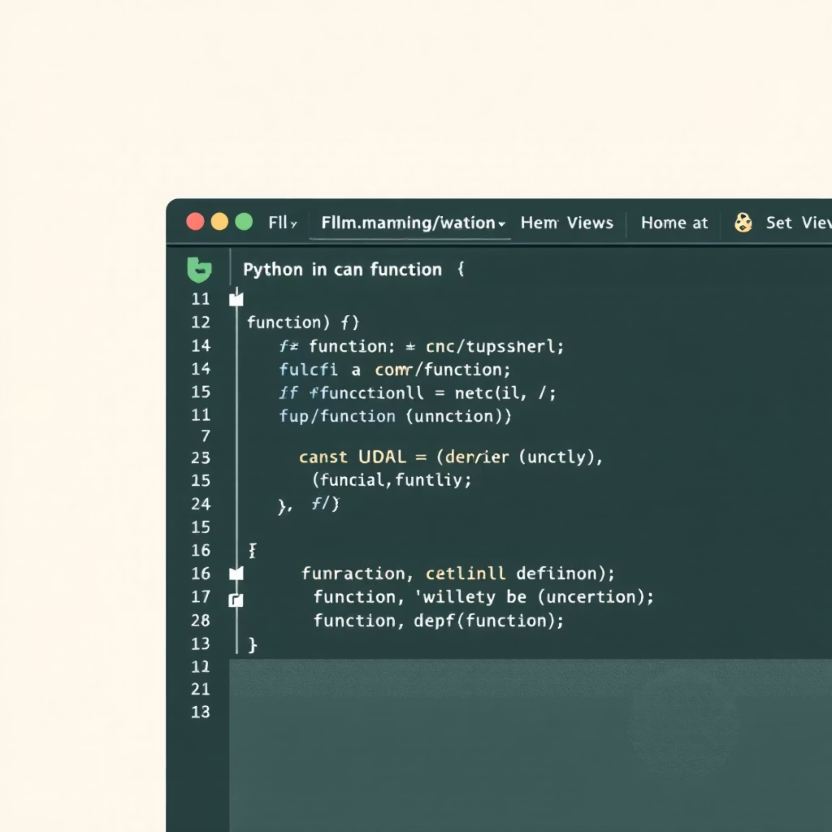
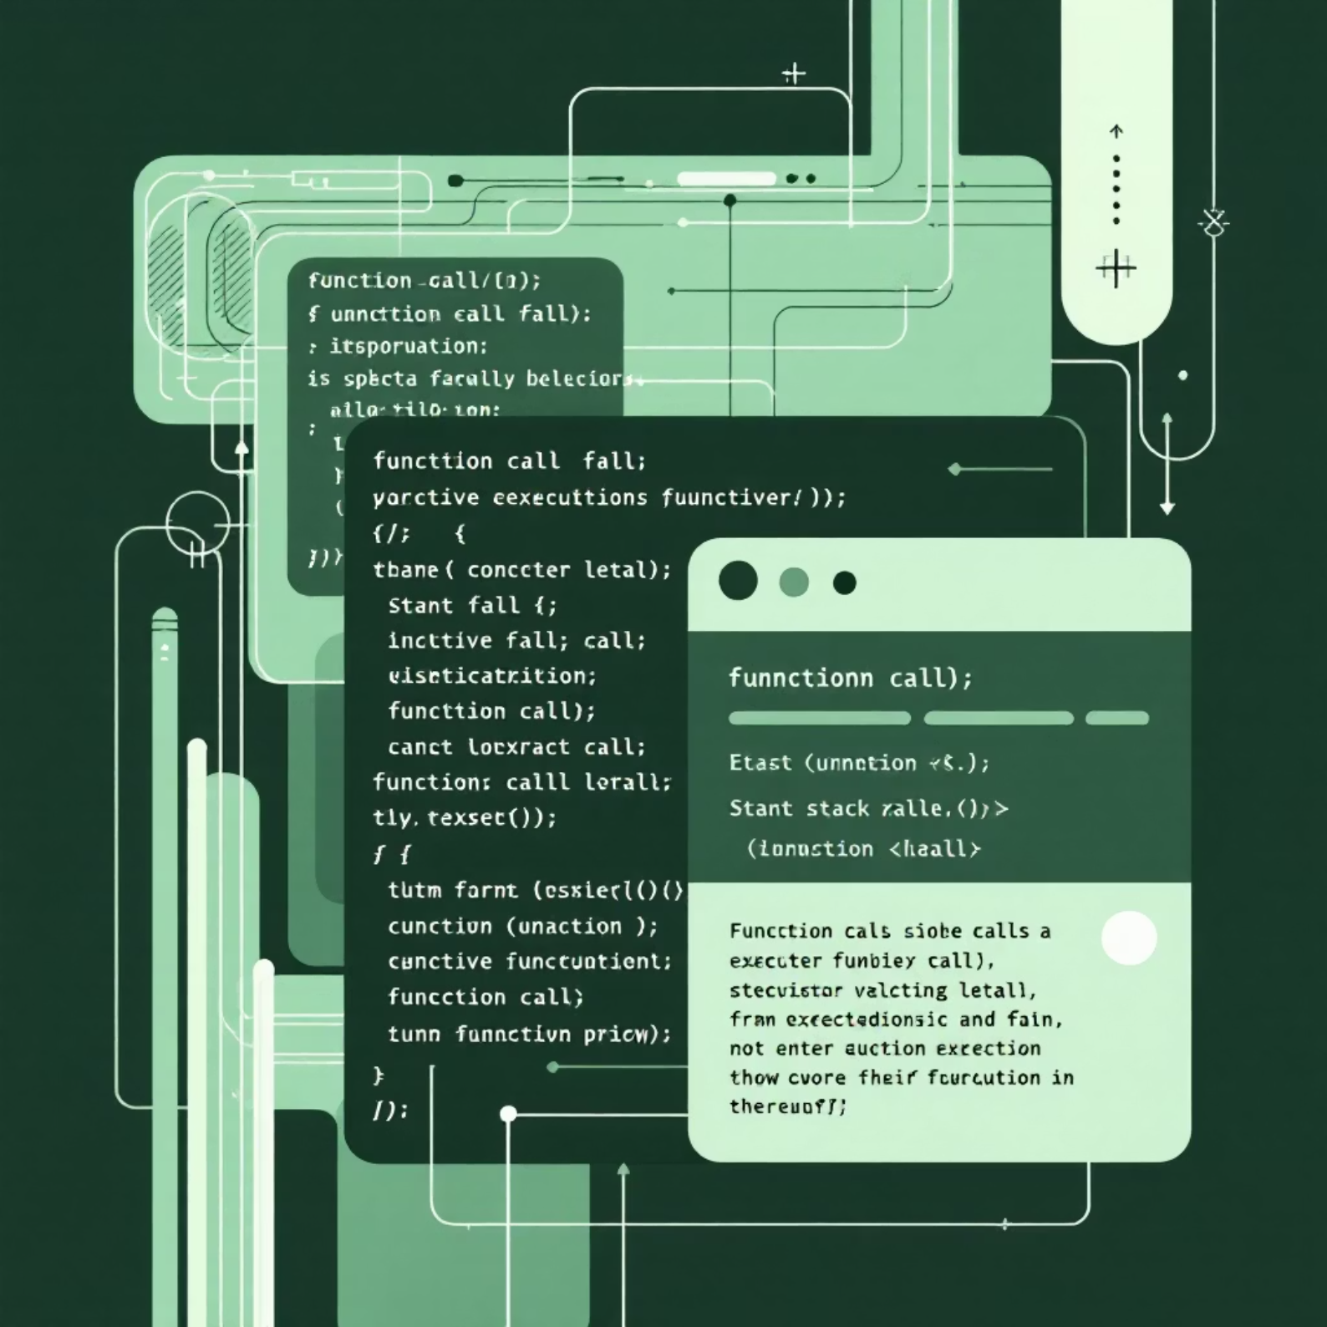
Defining and Calling Functions: Syntax and Basic Examples
The Building Blocks of Python Code
Basic Syntax
Defining a function in Python is straightforward, utilising the def keyword. This marks the beginning of a function definition, followed by the function's name and a set of parentheses, which may contain parameters.
def my_function(): print("Hello from a function!")my_function() # Calling the function
Calling a function is equally simple. Once defined, you can execute its block of code by merely using its name followed by parentheses. This triggers the function to perform its designated task.
This simple example demonstrates how to define a function that prints a message and then how to call it to execute the print statement.

Slide 4
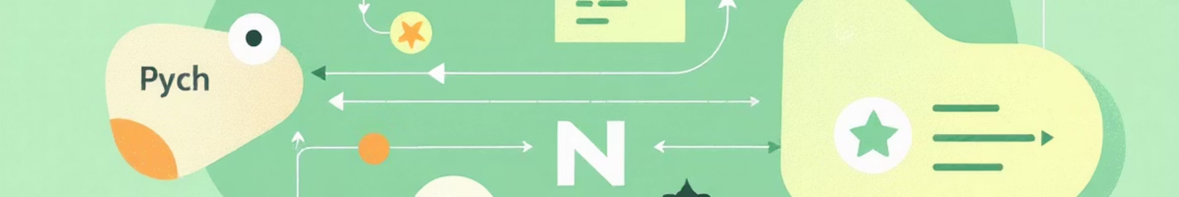



Parameters and Arguments: Passing Information to Your Functions
Parameters Defined
Arguments Passed
Types of Arguments
Parameters are placeholders listed inside the parentheses in the function definition. They specify what kind of information the function expects to receive.
Arguments are the actual values sent to the function when it is called. These values correspond to the parameters defined in the function signature.
Positional Arguments
Keyword Arguments
Default Arguments
Arbitrary Arguments
Understanding the distinction between parameters and arguments is crucial for writing flexible and powerful functions that can adapt to different inputs.

Slide 5
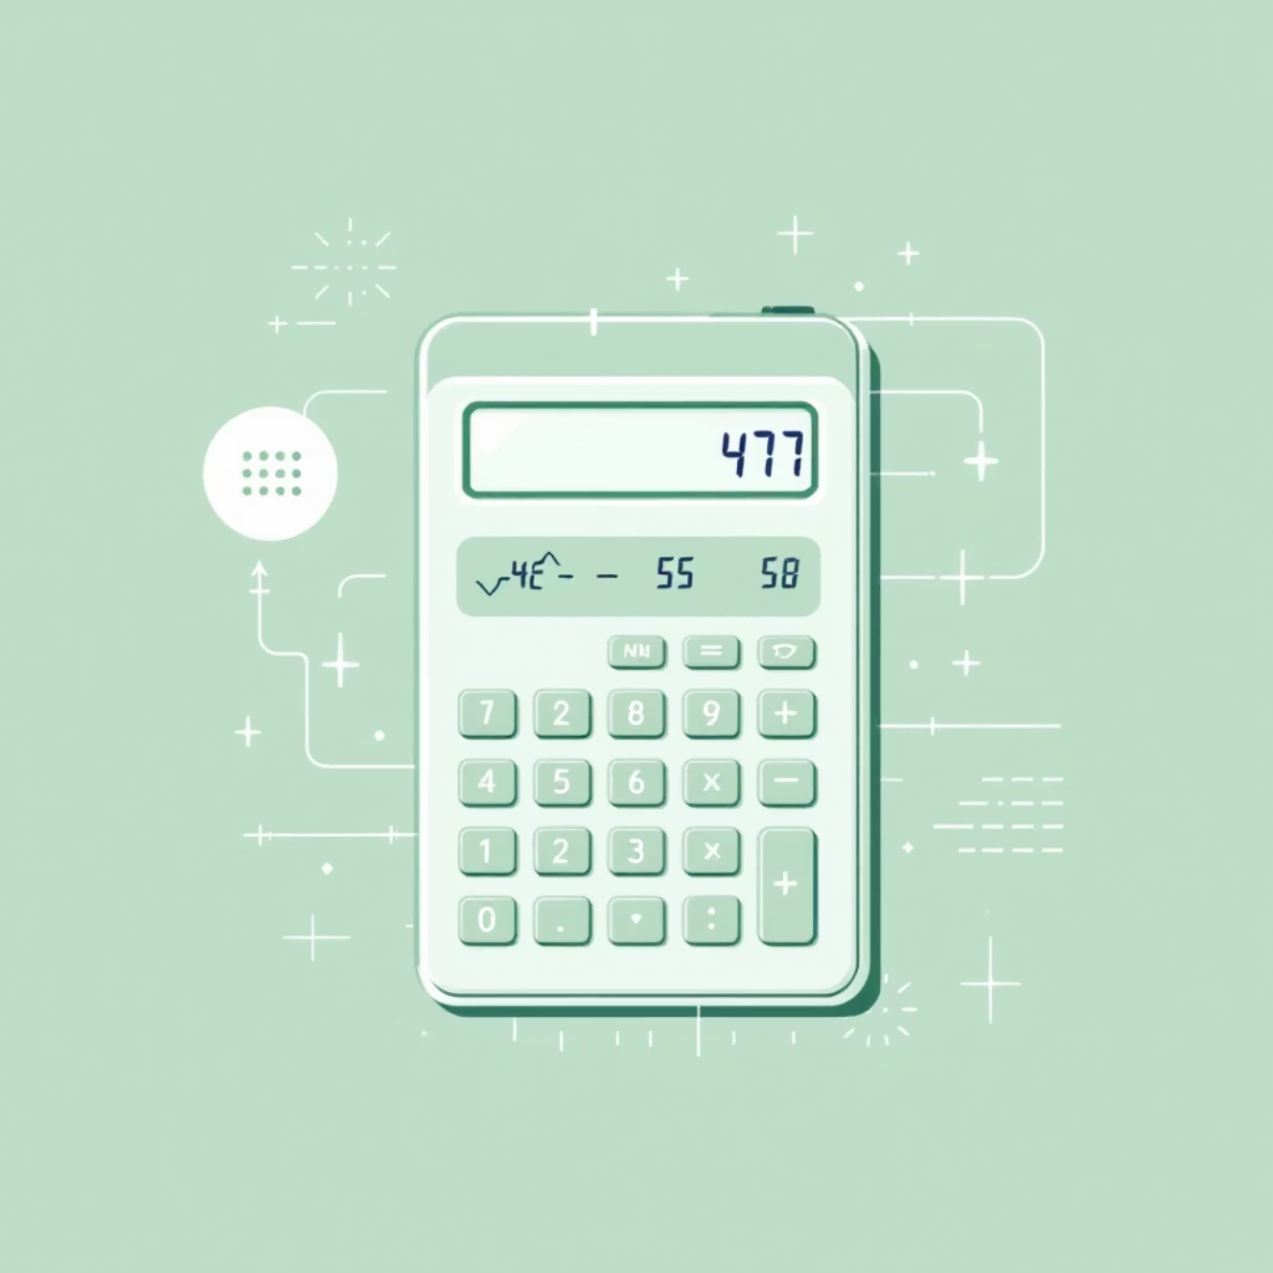

Return Values: Getting Results Back from Your Functions
Functions don't just perform actions; they can also provide results. The return statement in Python is used to send a value back from a function to the place where it was called.
This allows you to store the function's output in a variable, use it in further calculations, or display it directly. Without a return statement, a function implicitly returns None.
Example: Calculating Sum
def add_numbers(a, b): result = a + b return resultsum_val = add_numbers(5, 3)print(sum_val) # Output: 8
Beyond Simple Operations
Returning values is fundamental for creating functions that contribute meaningfully to your program's logic and data manipulation.

Slide 6

Best Practices and Next Steps: Writing Clean and Effective Functions
Descriptive Naming
Choose clear, concise names that reflect the function's purpose. This significantly improves code readability.
Single Responsibility
Each function should do one thing and do it well. Avoid functions that try to accomplish too many tasks.
Comments and Docstrings
Explain what your function does, its parameters, and what it returns. This is invaluable for others (and your future self).
Error Handling
Implement robust error handling to gracefully manage unexpected inputs or situations, making your functions more reliable.
By adhering to these best practices, you'll craft functions that are not only effective but also maintainable and easy to work with.

Slide 7

Thank You
We appreciate your attention and hope this presentation has deepened your understanding of Python functions.

